Slide 1
MArkov Chain
Session 12
Henry Lucky, S.Kom., M.Kom.

Slide 2
Learning Outcomes
Session 12
At the end of this session, students will be able to:
LO 4: Apply various techniques to an agent when acting under certainty

Slide 3
outline
Session 12
Markov Chain
Hidden Markov Chain
Forward Algorithm

Slide 4
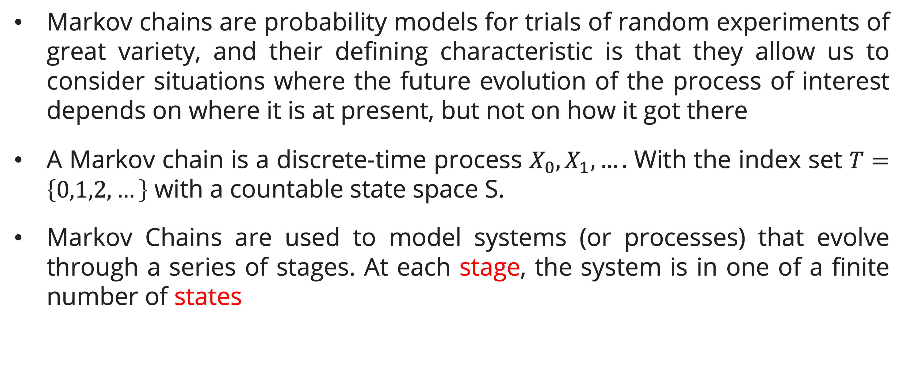
Markov Chain
Introduction
Markov chains are probability models for trials of random experiments of great variety, and their defining characteristic is that they allow us to consider situations where the future evolution of the process of interest depends on where it is at present, but not on how it got there
A Markov chain is a discrete-time process $X_{0},X_{1},….$ With the index set $T=\left\{0,1,2,…\right\}$ with a countable state space S.
Markov Chains are used to model systems (or processes) that evolve through a series of stages. At each stage, the system is in one of a finite number of states

Slide 5
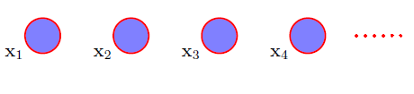
Markov Chain
definition
The easiest way to treat sequential data would be simply to ignore the sequential aspects and treat the observation as independent and identically distributed (i.i.d).
However, such approach would fail to exploit the sequential patterns in the data such as correlation between observations that are close in the sequence.

Slide 6
Markov Chain
definition
As an example, consider the three-storey aviary at a local zoo which houses 300 small birds. The aviary has three levels, and the birds spend their day flying around from one favorite perch to the next. Thus, at any given time the birds seem to be randomly distributed throughout the three levels, except at feeding time when they all fly to the bottom level.
Our problem is to determine what the probability is of a given bird being at a given level of the aviary at a given time. Of course, the birds are always flying from one level to another, so the bird population on each level is constantly fluctuating. We shall use a Markov chain to model this situation.

Slide 7
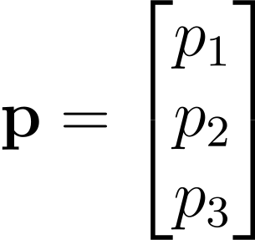
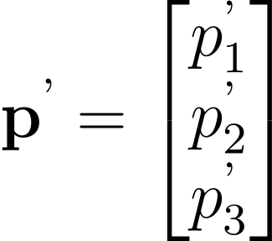
Markov Chain
formulation
Consider a 3×1 matrix
Where p1 is the percentage of total birds on the first level, p2 is the percentage on the second level, and p3 is the percentage on the third level. Note that p1 + p2 + p3 = 1 = 100%.
After 5 min we have new matrix
Giving a new distribution of the birds

Slide 8
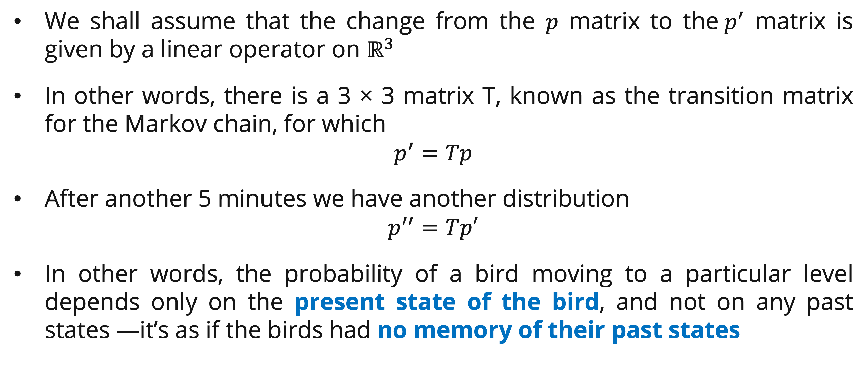
Markov Chain
formulation
We shall assume that the change from the $p$ matrix to the$p^{′}$ matrix is given by a linear operator on $ℝ^{3}$
In other words, there is a 3 × 3 matrix T, known as the transition matrix for the Markov chain, for which
$$p^{′}=Tp$$
After another 5 minutes we have another distribution
$$p^{′′}=Tp′$$
In other words, the probability of a bird moving to a particular level depends only on the present state of the bird, and not on any past states —it’s as if the birds had no memory of their past states

Slide 9
Markov Chain
formulation
The matrix p described before is called a probability vectors.
The transition matrix T described before that takes the system from one distribution to another is a stochastic matrix.
Stochastic matrix is a square matrix whose columns are probability vectors

Slide 10
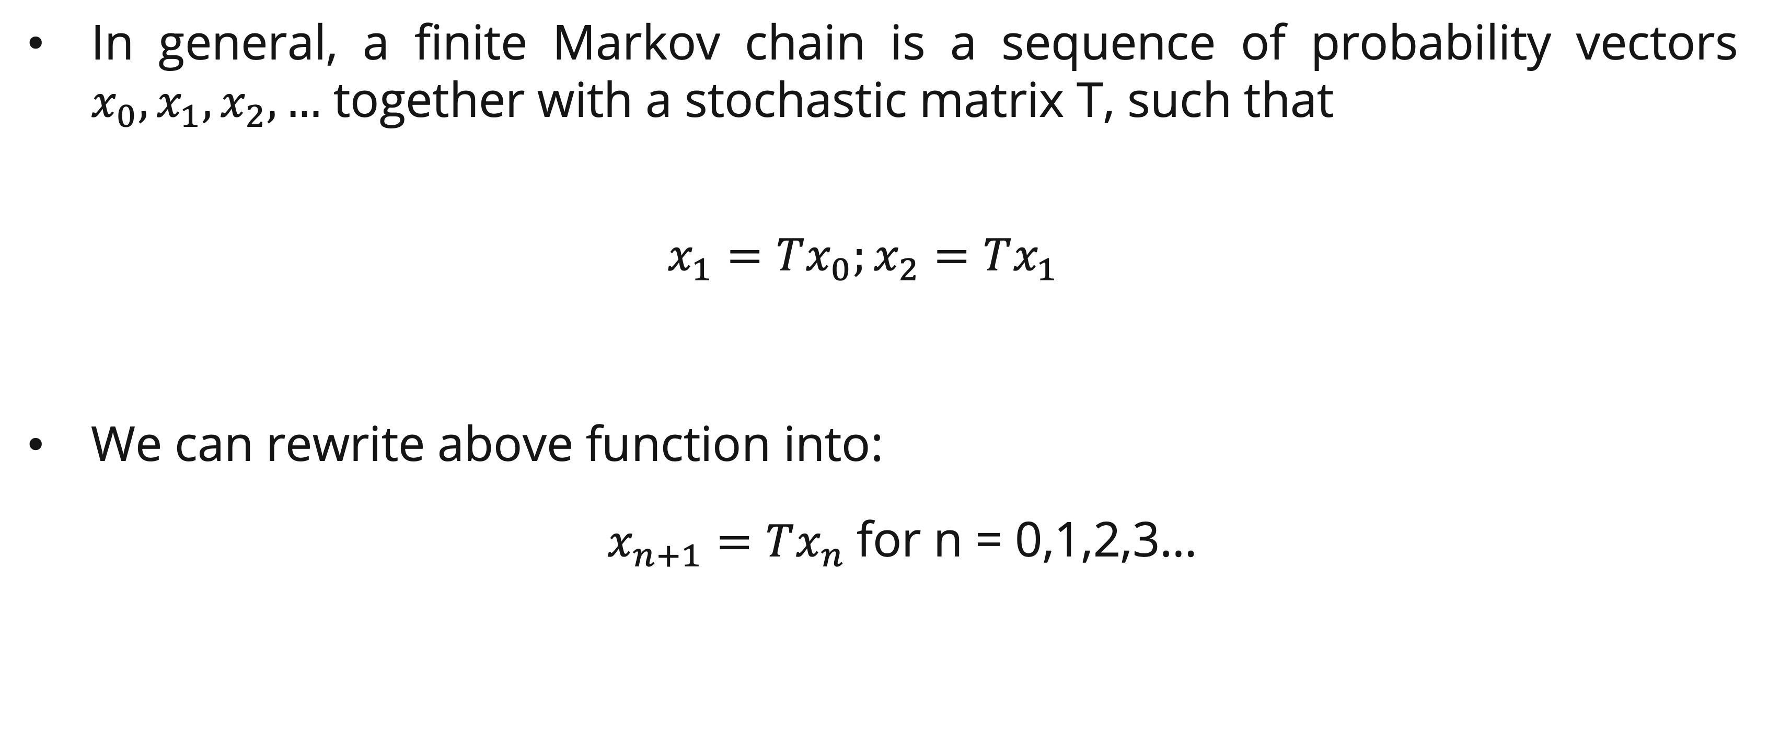
Markov Chain
formulation
In general, a finite Markov chain is a sequence of probability vectors $x_{0}, x_{1}, x_{2},…$ together with a stochastic matrix T, such that
  $$x_{1}=Tx_{0};x_{2}=Tx_{1}$$
We can rewrite above function into:
  $x_{n+1}=Tx_{n}$for n = 0,1,2,3…

Slide 11
Markov Chain
example
Markov Model: The probability of the transition from one state to another can be packed into a transition matrix.
Consider a simple weather model where the weather can be either "Sunny" (S) or "Rainy" (R). The weather transitions from one day to the next according to the following Markov chain probabilities:
  P(Sunny tomorrow | Sunny today) = 0.9
  P(Rainy tomorrow | Sunny today) = 0.1
  P(Sunny tomorrow | Rainy today) = 0.5
  P(Rainy tomorrow | Rainy today) = 0.5

Slide 12
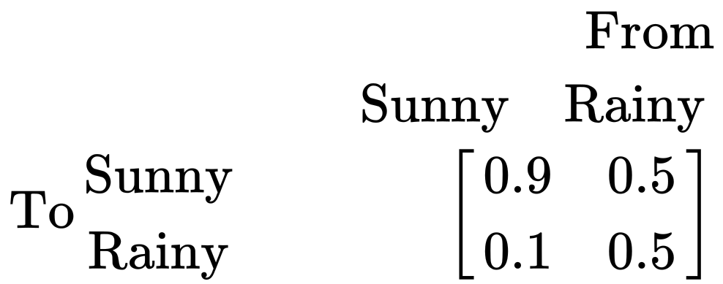
Markov Chain
example
The transition Diagram
The transition matrix from the transition diagram
What are the probability of rainy in 2 days, if today is rainy?
0.1
Sunny
Rainy
0.5
0.5
0.9

Slide 13
Markov Chain
example
There are two ways to solve the problem:
  Tree diagram
  Markov Chain

Slide 14
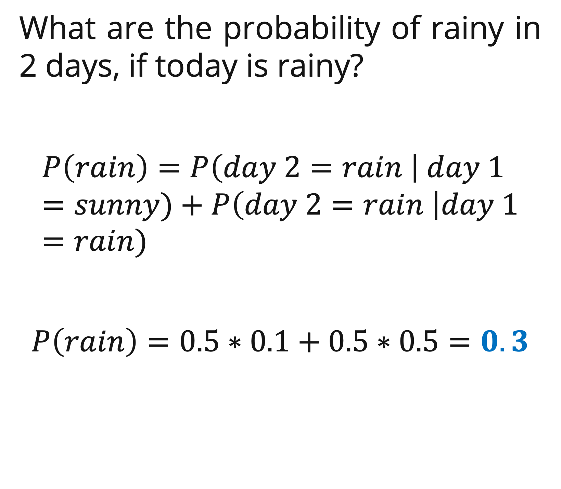
Markov Chain
Example: Tree diagram
0.9
What are the probability of rainy in 2 days, if today is rainy?
$$P\left(rain\right)=P\left(day 2=rain \right| day 1=sunny)+P\left(day 2=rain \right|day 1=rain)$$
$$P\left(rain\right)=0.5∗0.1+0.5∗0.5=0.3$$
SUNNY
SUNNY
0.5
RAINY
0.1
RAINY
0.5
0.5
RAINY
SUNNY
0.5
RAINY
Day 1
Day 2

Slide 15

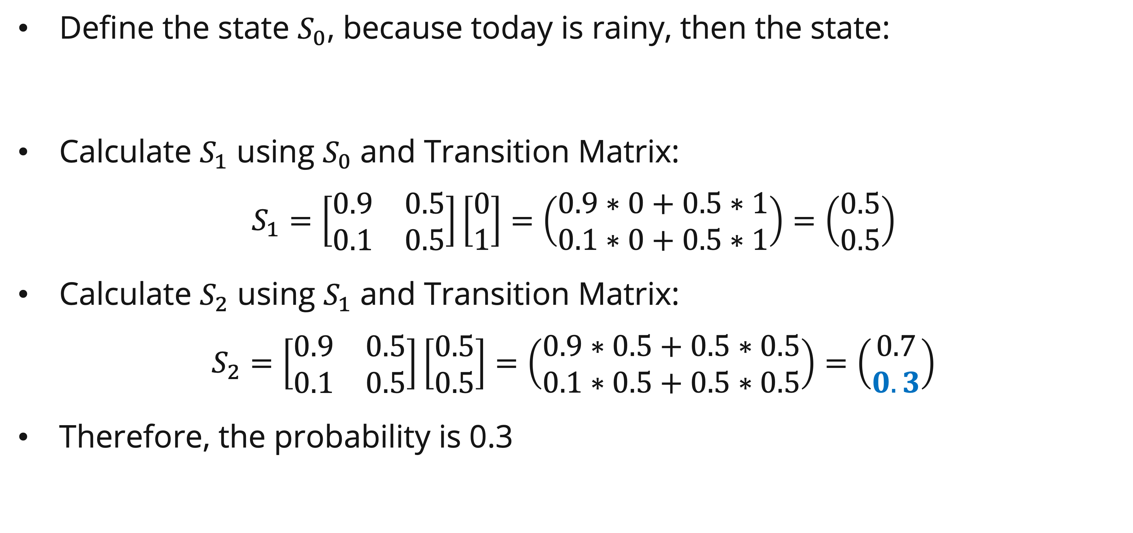
Markov Chain
Example: Markov chain
Define the state $S_{0}$, because today is rainy, then the state:
Calculate $S_{1}$ using $S_{0}$ and Transition Matrix:
$$S_{1}=\left[\begin{matrix}0.9 & 0.5 \\ 0.1 & 0.5\end{matrix}\right]\left[\begin{matrix}0 \\ 1\end{matrix}\right]=\left(\begin{matrix}0.9∗0+0.5∗1 \\ 0.1∗0+0.5∗1\end{matrix}\right)=\left(\begin{matrix}0.5 \\ 0.5\end{matrix}\right)$$
Calculate $S_{2}$ using $S_{1}$ and Transition Matrix:
$$S_{2}=\left[\begin{matrix}0.9 & 0.5 \\ 0.1 & 0.5\end{matrix}\right]\left[\begin{matrix}0.5 \\ 0.5\end{matrix}\right]=\left(\begin{matrix}0.9∗0.5+0.5∗0.5 \\ 0.1∗0.5+0.5∗0.5\end{matrix}\right)=\left(\begin{matrix}0.7 \\ 0.3\end{matrix}\right)$$
Therefore, the probability is 0.3
Sunny
Rainy

Slide 16
Hidden Markov model
definition
Hidden Markov Models (HMM) are used for situations in which:​
  The data consists of a sequence of observations​
  The observations depend (probabilistically) on the internal state of dynamic system​
  The true state of the system is unknown (it is hidden or latent) ​
Why is it called Hidden Markov Model?​
  We are constructing an inference model based on the assumptions of Markov Process. ​
  The Markov process assumption is simply that the “future is independent of the past given the present”​

Slide 17
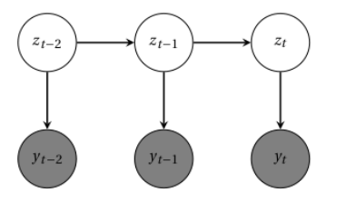

Hidden Markov model
definition
In Hidden Markov Model (HMM), the sequence of T output variable $y_{t}$ is generated by a parallel sequence of latent categorical state variables $z_{t}∈\{1, …, K\}$. These hidden states are a Markov chain, so that $z_{t}$ is conditionally independent of other variables given $z_{t−1}$
Hidden State
Observed State

Slide 18
Hidden Markov model
definition
Generally, the term “states” are used to refer to the hidden states and “observations” are used to refer to the observed states.
  Transition data – the probability of transitioning to a new state conditioned on a present state
  Emission data – the probability of transitioning to an observed state condition on a hidden state
  Initial state information – The initial probability of transitioning to a hidden state. This can be looked like the prior probability

Slide 19
Hidden Markov model
example
Consider Jack who is living in Gotham city, the city is unique only have three weather: rainy, cloudy and sunny. It only occur once a day, and tomorrow weather depends on the today weather.
In one day, Jack can have two mood sad or happy and it depends on weather. Supposed we observed: the day is sunny, and jack is happy; next day is cloudy and jack is happy; but the third day is sunny, but jack is sad.
What is the probability of the given observation?

Slide 20
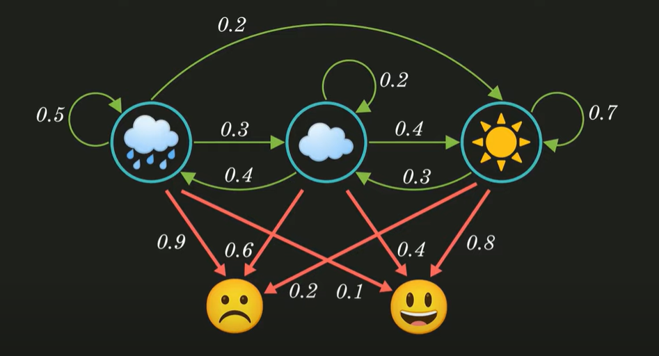
Hidden Markov model
example
Transition Diagram
Emission Diagram

Slide 21
Hidden Markov model
example
We don’t know the weather, but we know Jack’s mood:
Hidden States
Observed Variable

Slide 22
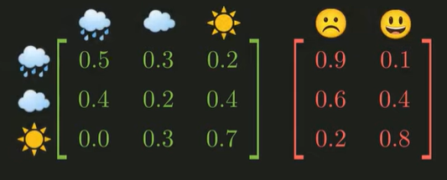
Hidden Markov model
example
The state diagram

Slide 23
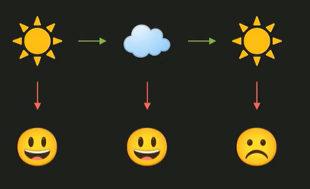
Hidden Markov model
example
Write The Transition diagram based on the condition:
  At first day: Weather : Sunny, Jack : Happy
  At Second day: Weather: cloudy, Jack: Happy
  At Third day: Weather: sunny, Jack: Sad

Slide 24
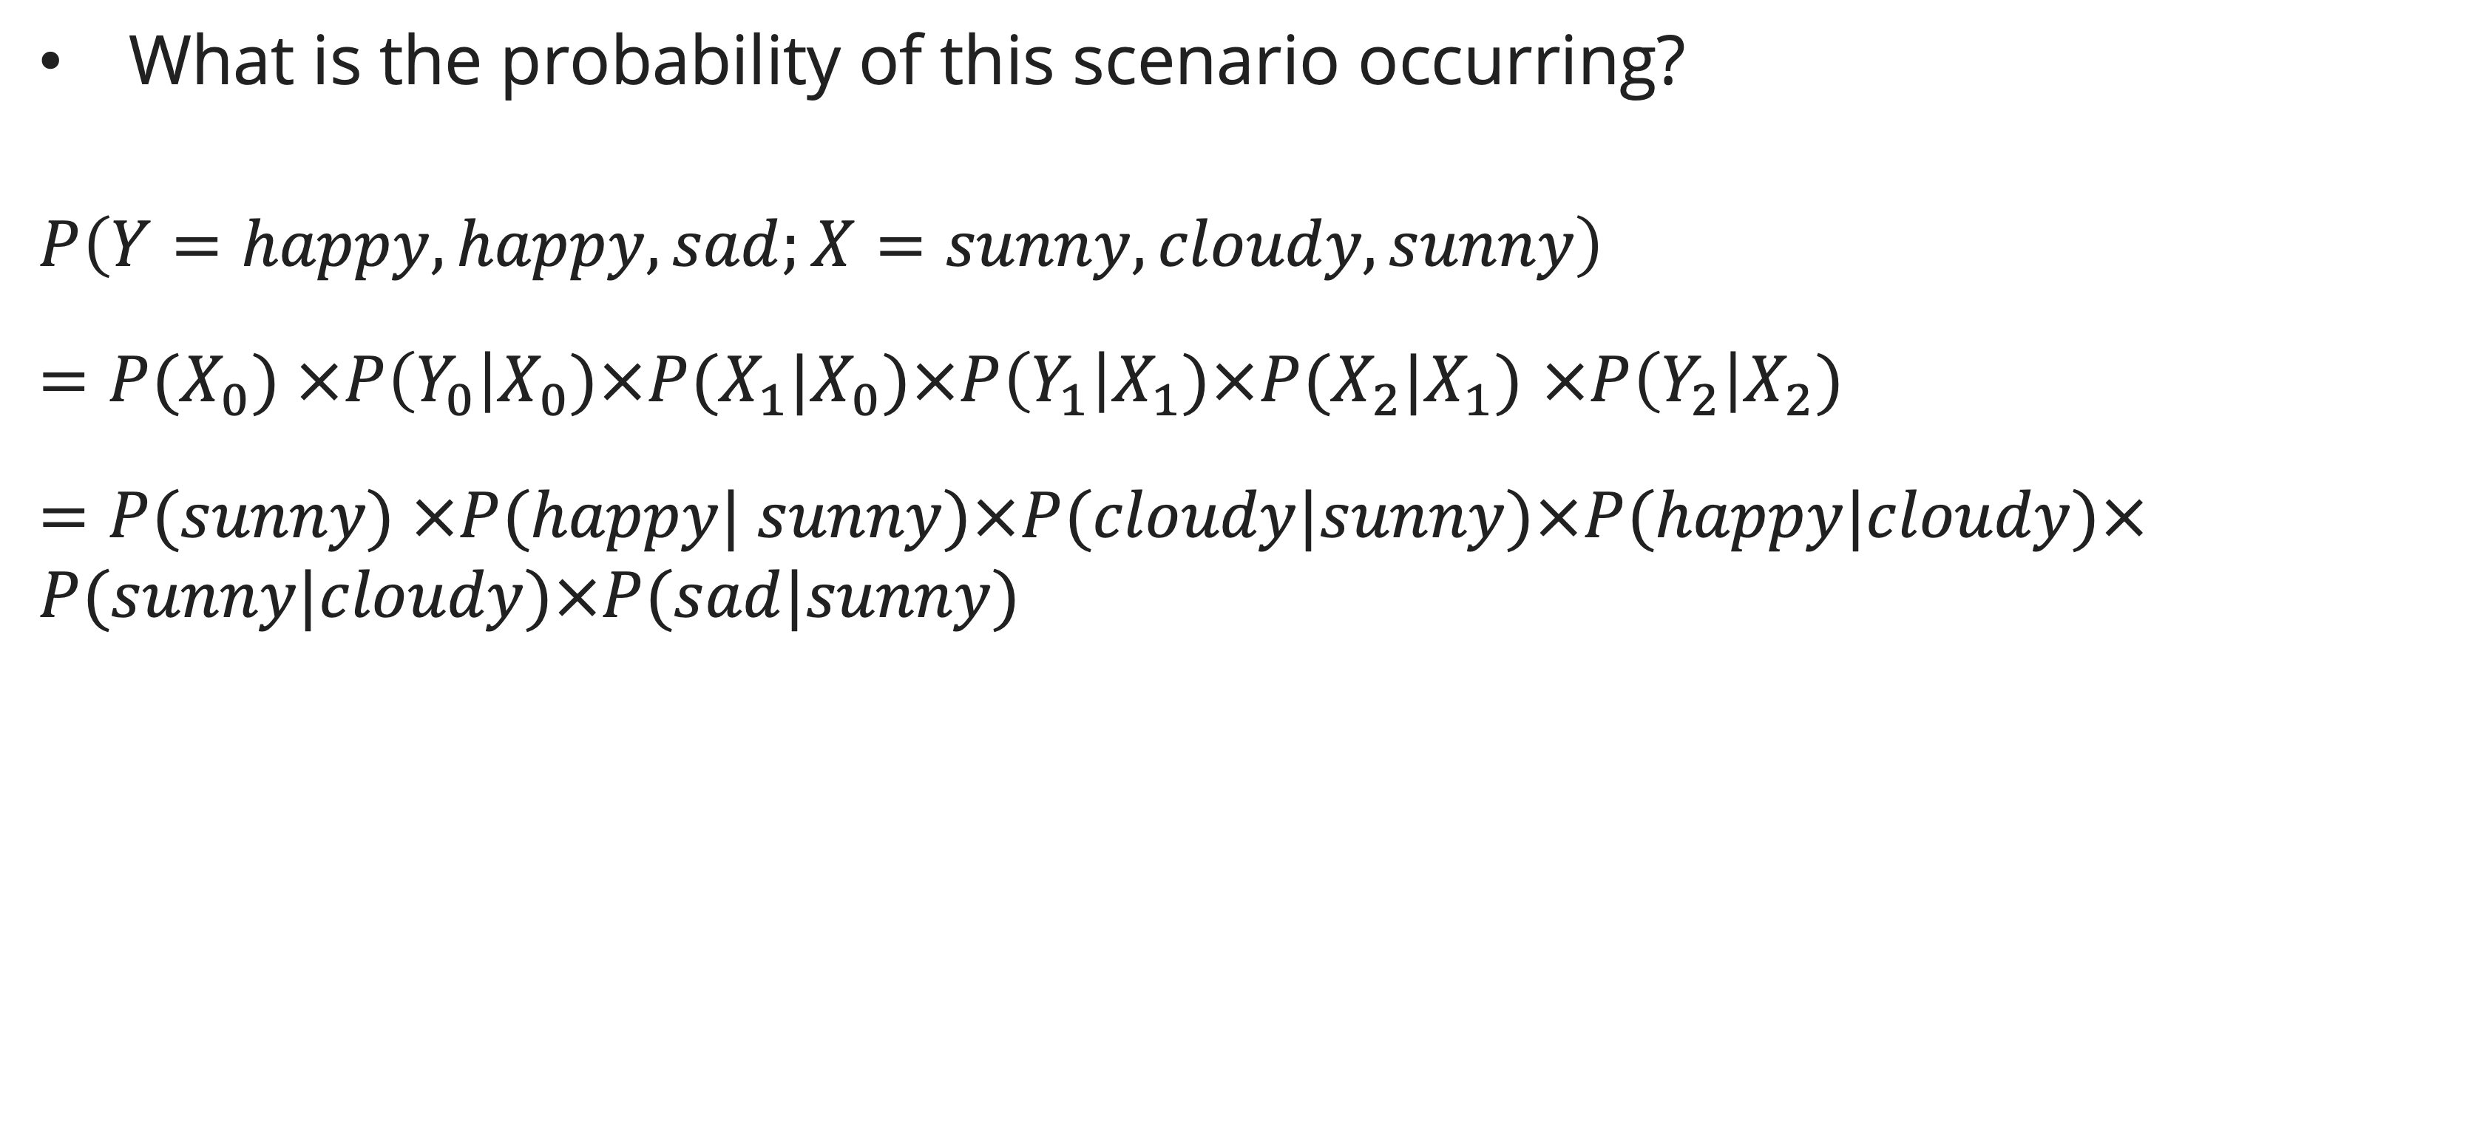
Hidden Markov model
example
What is the probability of this scenario occurring?
$P\left(Y=happy, happy, sad;X=sunny, cloudy, sunny\right)$
$=P(X_{0}) ×P\left(Y_{0}\right|X_{0})×P(X_{1}|X_{0})×P\left(Y_{1}\right|X_{1})×P(X_{2}|X_{1})$ $×P\left(Y_{2}\right|X_{2})$
$=P(sunny) ×P(happy| sunny)×P(cloudy|sunny)×P(happy|cloudy)×P(sunny|cloudy)×P(sad|sunny)$

Slide 25
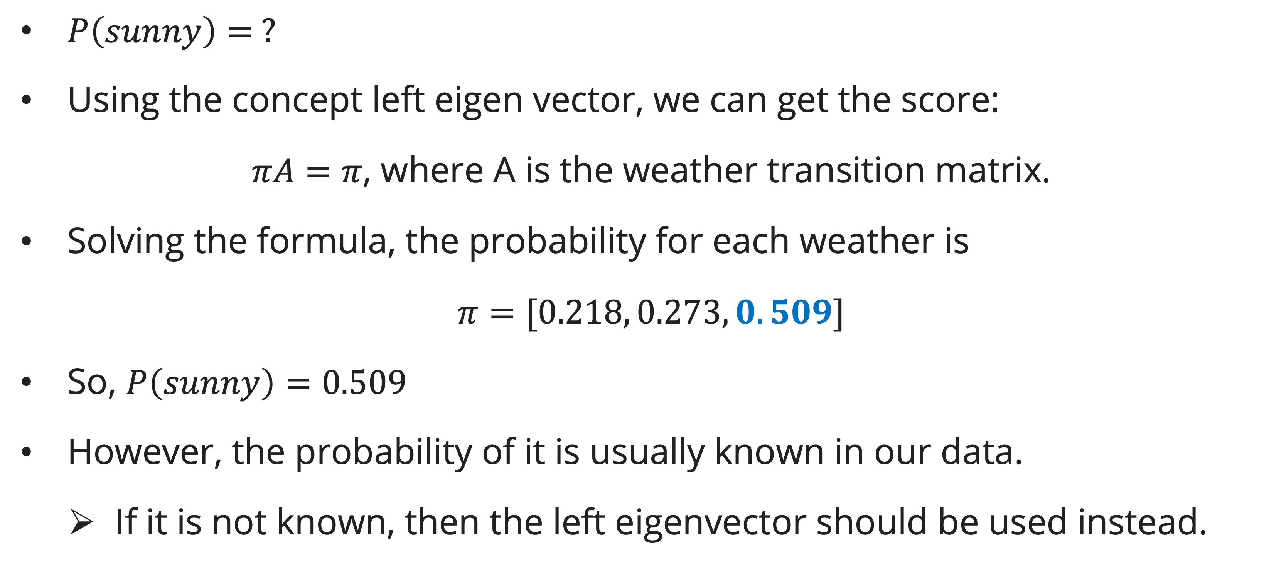
Hidden Markov model
example
$P\left(sunny\right)= ?$
Using the concept left eigen vector, we can get the score:
$πA=π$, where A is the weather transition matrix.
Solving the formula, the probability for each weather is
$π=[0.218, 0.273, 0.509]$
So, $P\left(sunny\right)=0.509$
However, the probability of it is usually known in our data.
  If it is not known, then the left eigenvector should be used instead.

Slide 26
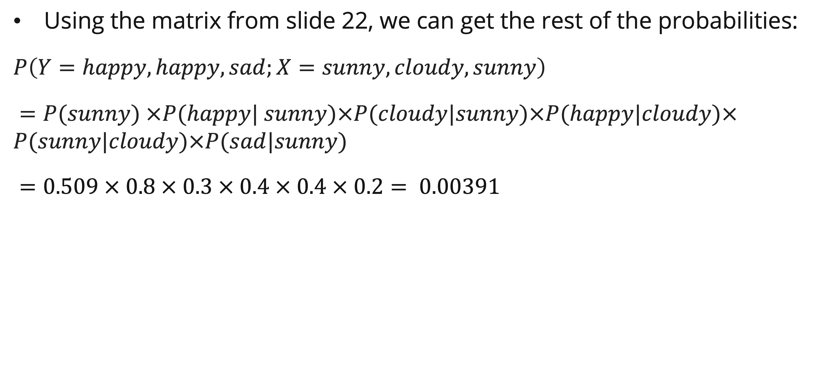
Hidden Markov model
example
Using the matrix from slide 22, we can get the rest of the probabilities:
$P\left(Y=happy, happy, sad;X=sunny, cloudy, sunny\right)$
$=P(sunny) ×P(happy| sunny)×P(cloudy|sunny)×P(happy|cloudy)×P(sunny|cloudy)×P(sad|sunny)$
$=0.509 × 0.8 × 0.3 × 0.4 × 0.4 × 0.2= 0.00391$

Slide 27
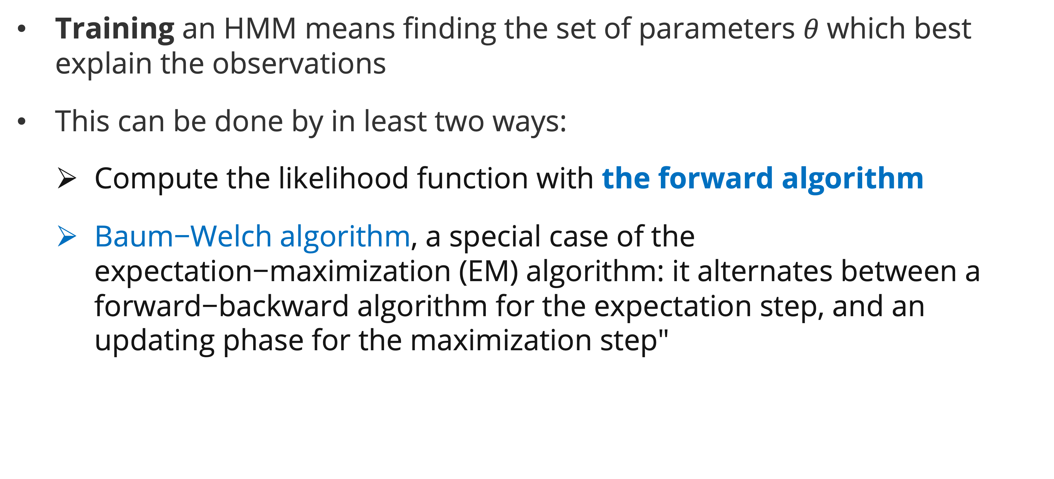
Hidden Markov model
Training
$\text{Training} \text{an} \text{HMM} \text{means} \text{finding} \text{the} \text{set} \text{of} \text{parameters} θ \text{which} \text{best} \text{explain} \text{the} \text{observations}$
$\text{This} \text{can} \text{be} \text{done} \text{by} \text{in} \text{least} \text{two} \text{ways}\text{: }$
  Compute the likelihood function with the forward algorithm
  Baum−Welch algorithm, a special case of the expectation−maximization (EM) algorithm: it alternates between a forward−backward algorithm for the expectation step, and an updating phase for the maximization step"

Slide 28

Forward algorithm
definition
The forward algorithm computes the likelihood function $p(y_{1}:T|θ)$of a hidden Markov model, given the values of its parameters 𝜃 .
These parameters come from the parametric expressions of $π_{0}, α_{i,j} (t)$and $b_{i}$

Slide 29
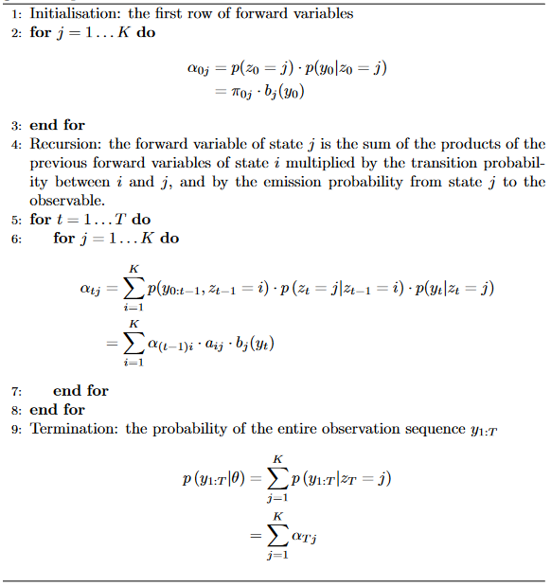
Forward algorithm
Algorithm

Slide 30
Forward algorithm
algorithm

Slide 31
Forward algorithm
example
Consider Jack who is living in Gotham city, the city is unique only have three weathers: rainy, and sunny and only occur once a day, and tomorrow weather depends on the today weather. In one day, Jack can have two mood sad or happy and depend on weather. Supposed we observed: the first two days Jack is sad, while the third day is happy.
What is the probability of this observed sequence given the parameters of our HMM?

Slide 32
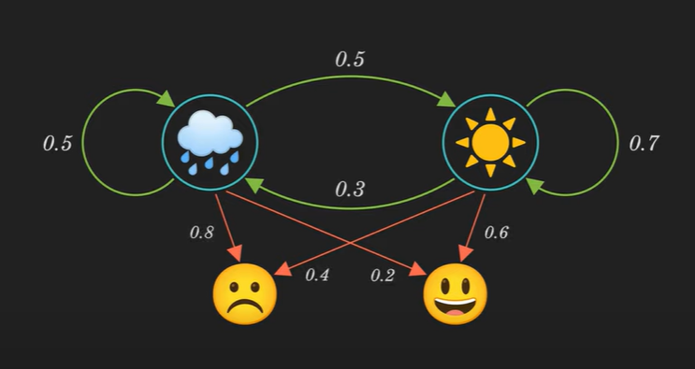
Forward algorithm
example

Slide 33
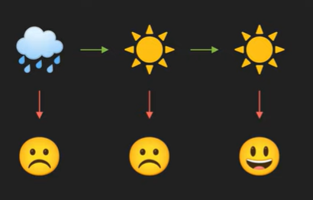

Forward algorithm
example
Mathematic for the observed state:
$P\left(Y=Y_{0}, Y_{0}, Y_{1}\right)=?$
Assume the possibility of the Hidden states. (First Day is rainy, Second Day is sunny, and third day is sunny

Slide 34
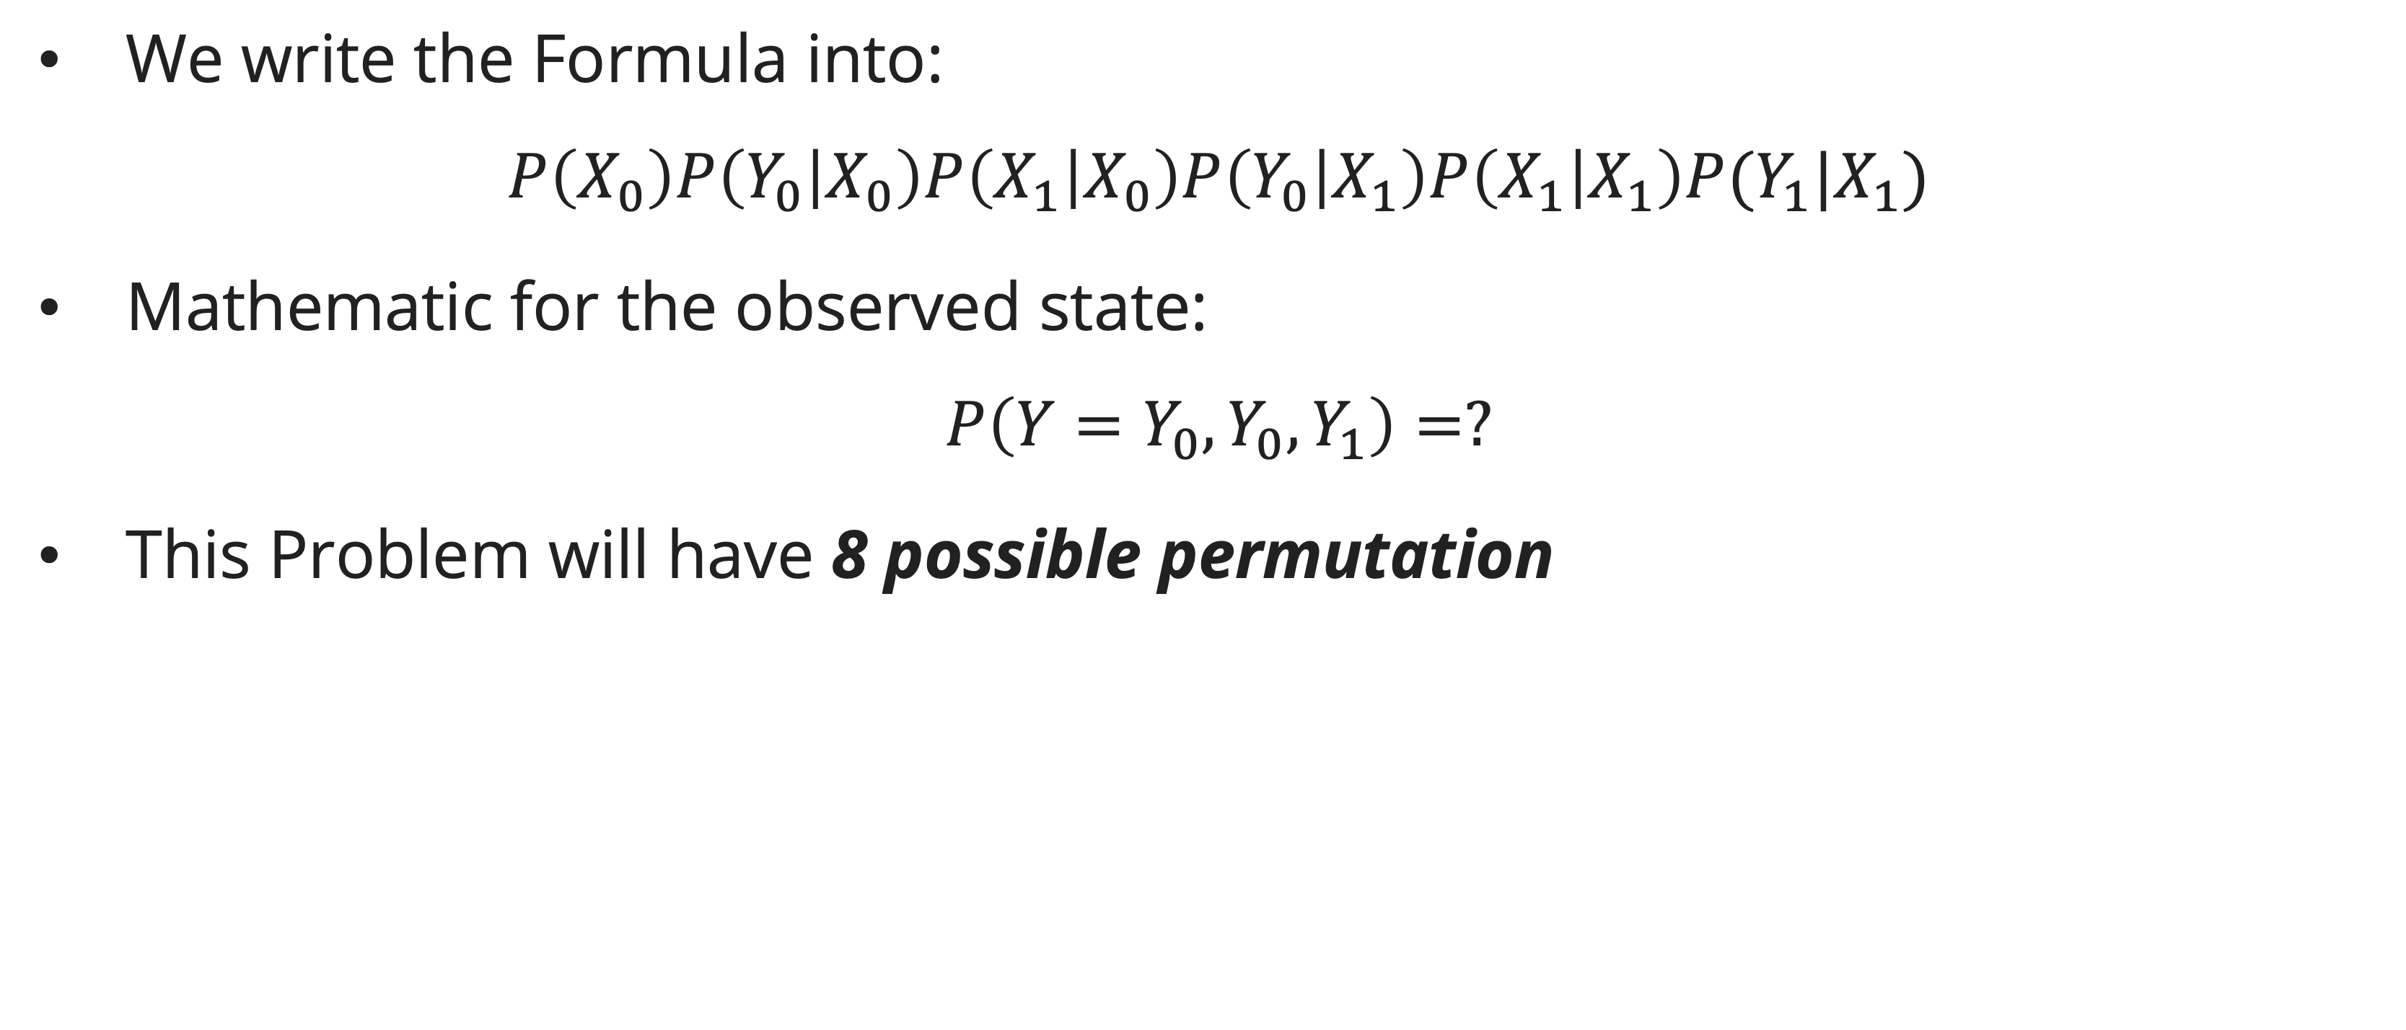
Forward algorithm
example
We write the Formula into:
$$P\left(X_{0}\right)P\left(Y_{0} | X_{0}\right)P\left(X_{1} | X_{0}\right)P\left(Y_{0} | X_{1}\right)P\left(X_{1} | X_{1}\right)P(Y_{1}|X_{1})$$
Mathematic for the observed state:
$$P\left(Y=Y_{0}, Y_{0}, Y_{1}\right)=?$$
This Problem will have 8 possible permutation

Slide 35
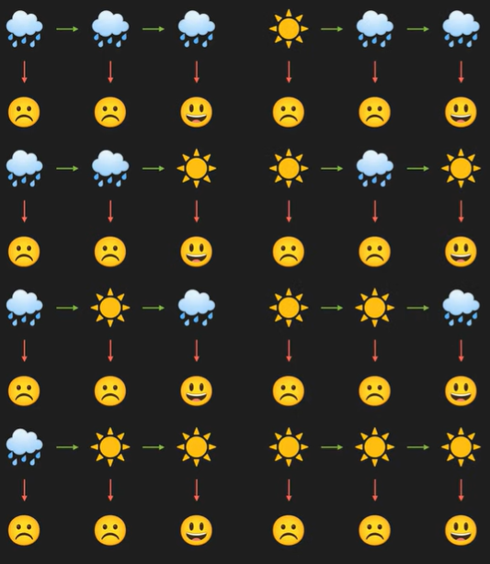
Forward algorithm
example

Slide 36
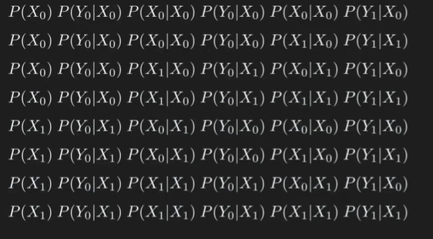
Forward algorithm
example

Slide 37
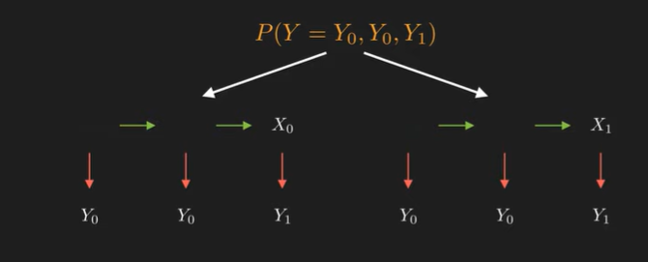
Forward algorithm
example

Slide 38
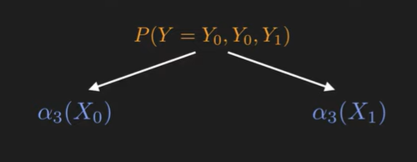
Forward algorithm
example

Slide 39
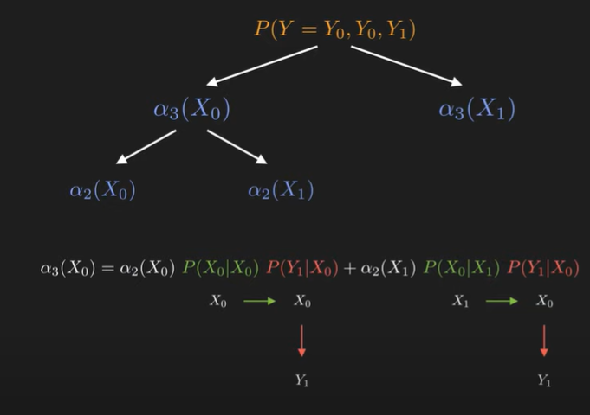
Forward algorithm
example

Slide 40
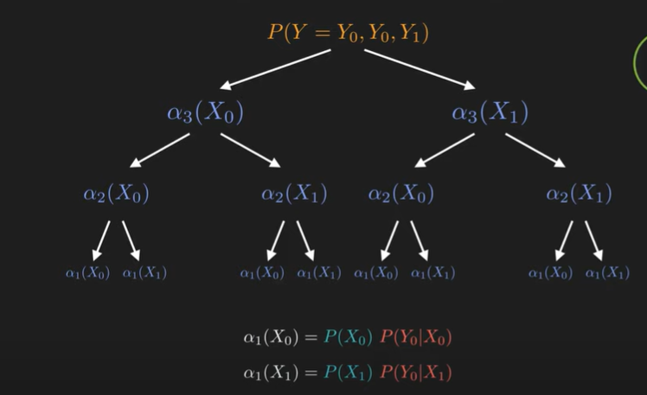
Forward algorithm
example

Slide 41
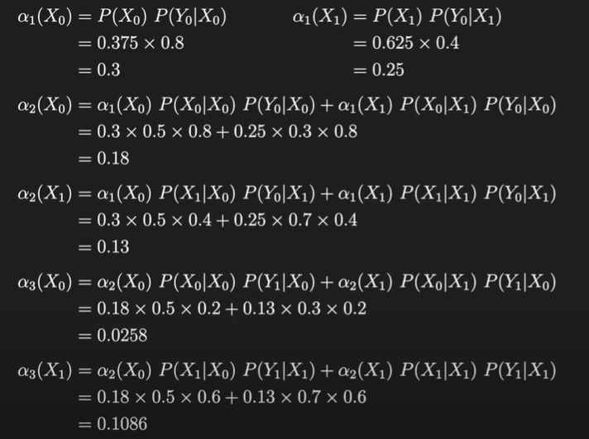
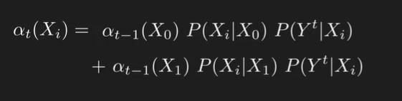
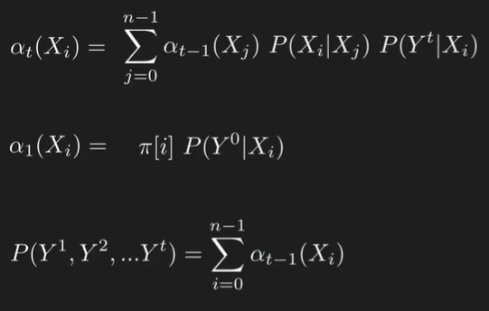
Forward algorithm
example

Slide 42
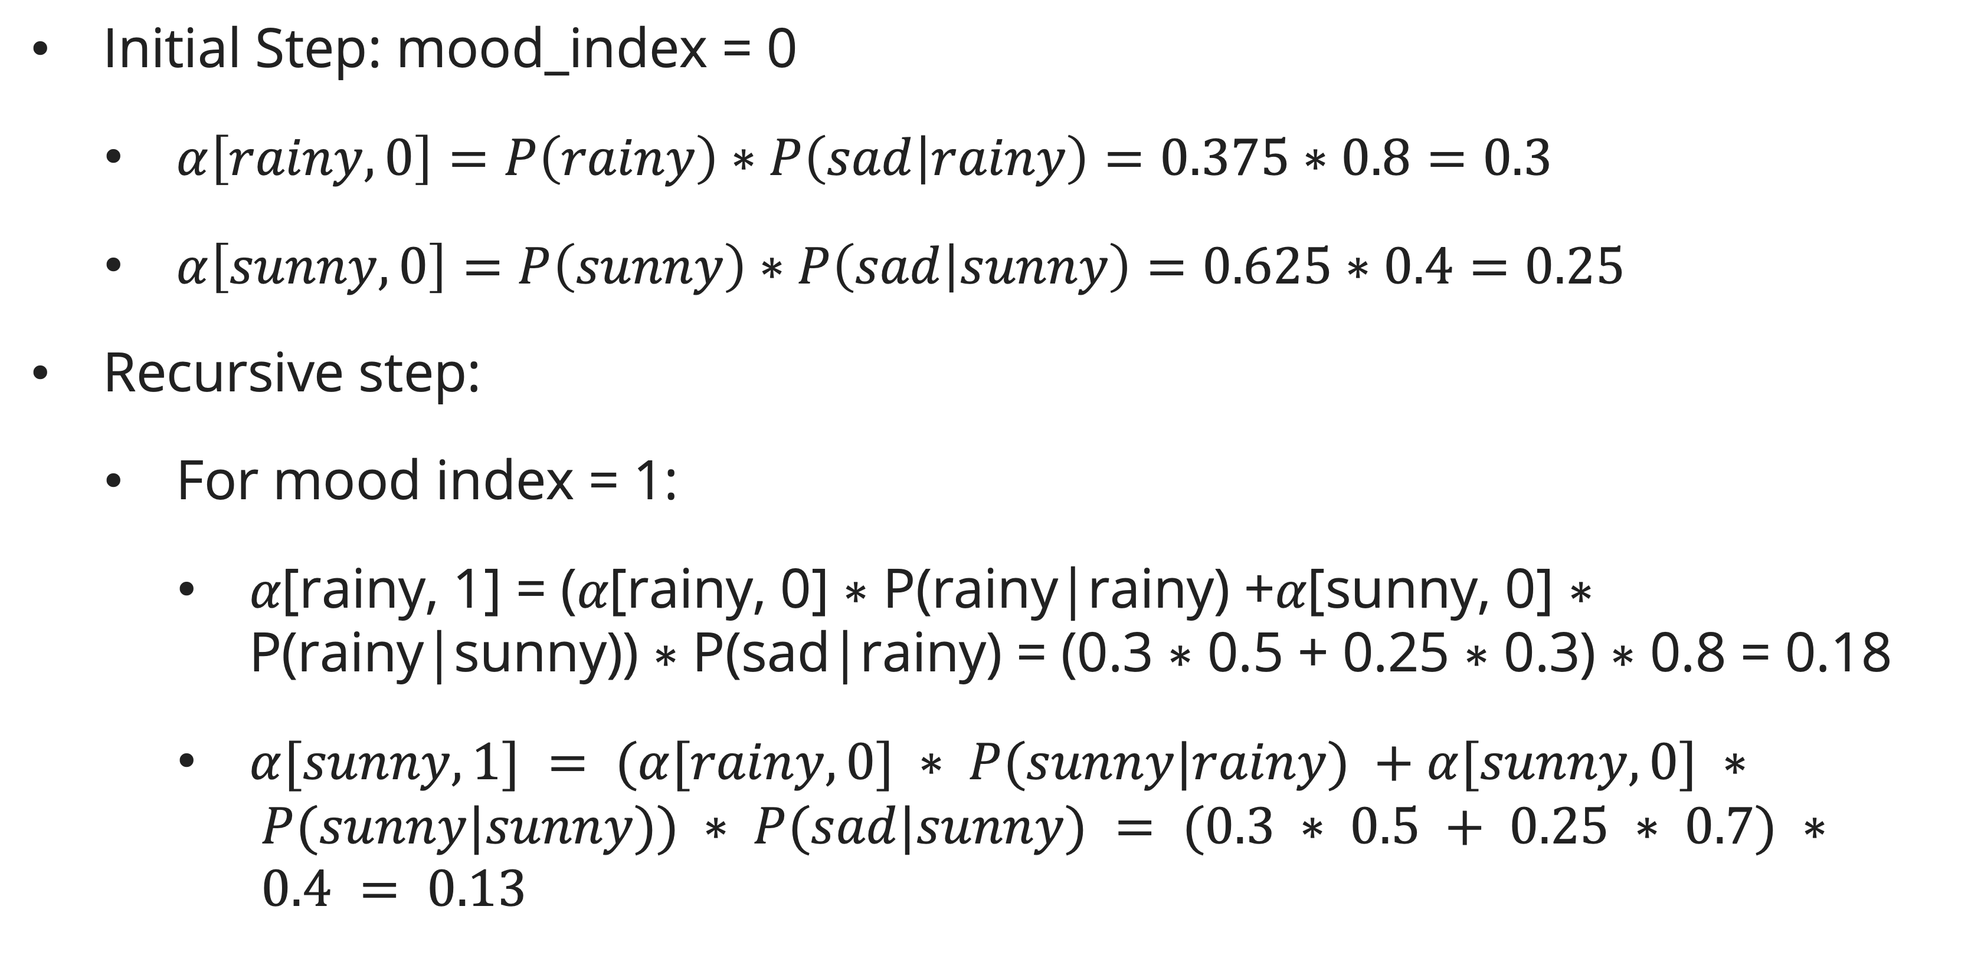
Forward algorithm
example
Initial Step: mood_index = 0
  $α\left[rainy, 0\right]=P\left(rainy\right)∗P\left(sad | rainy\right)=0.375∗0.8=0.3$
  $α\left[sunny, 0\right]=P\left(sunny\right)∗P\left(sad | sunny\right)=0.625∗0.4=0.25$
Recursive step:
  For mood index = 1:
    $α\text{[}\text{rainy}\text{, 1] = (}α\text{[}\text{rainy}\text{, 0] ∗ }\text{P}\text{(}\text{rainy}\text{|}\text{rainy}\text{) +}α\text{[}\text{sunny}\text{, 0] ∗ }\text{P}\text{(}\text{rainy}\text{|}\text{sunny}\text{)) ∗ }\text{P}\text{(}\text{sad}\text{|}\text{rainy}\text{) = (0.3 ∗ 0.5 + 0.25 ∗ 0.3) ∗ 0.8 = 0.1}\text{8}$
    $α[sunny, 1] = (α[rainy, 0] ∗ P(sunny|rainy) +α[sunny, 0] ∗ P(sunny|sunny)) ∗ P(sad|sunny) = (0.3 ∗ 0.5 + 0.25 ∗ 0.7) ∗ 0.4 = 0.13$

Slide 43
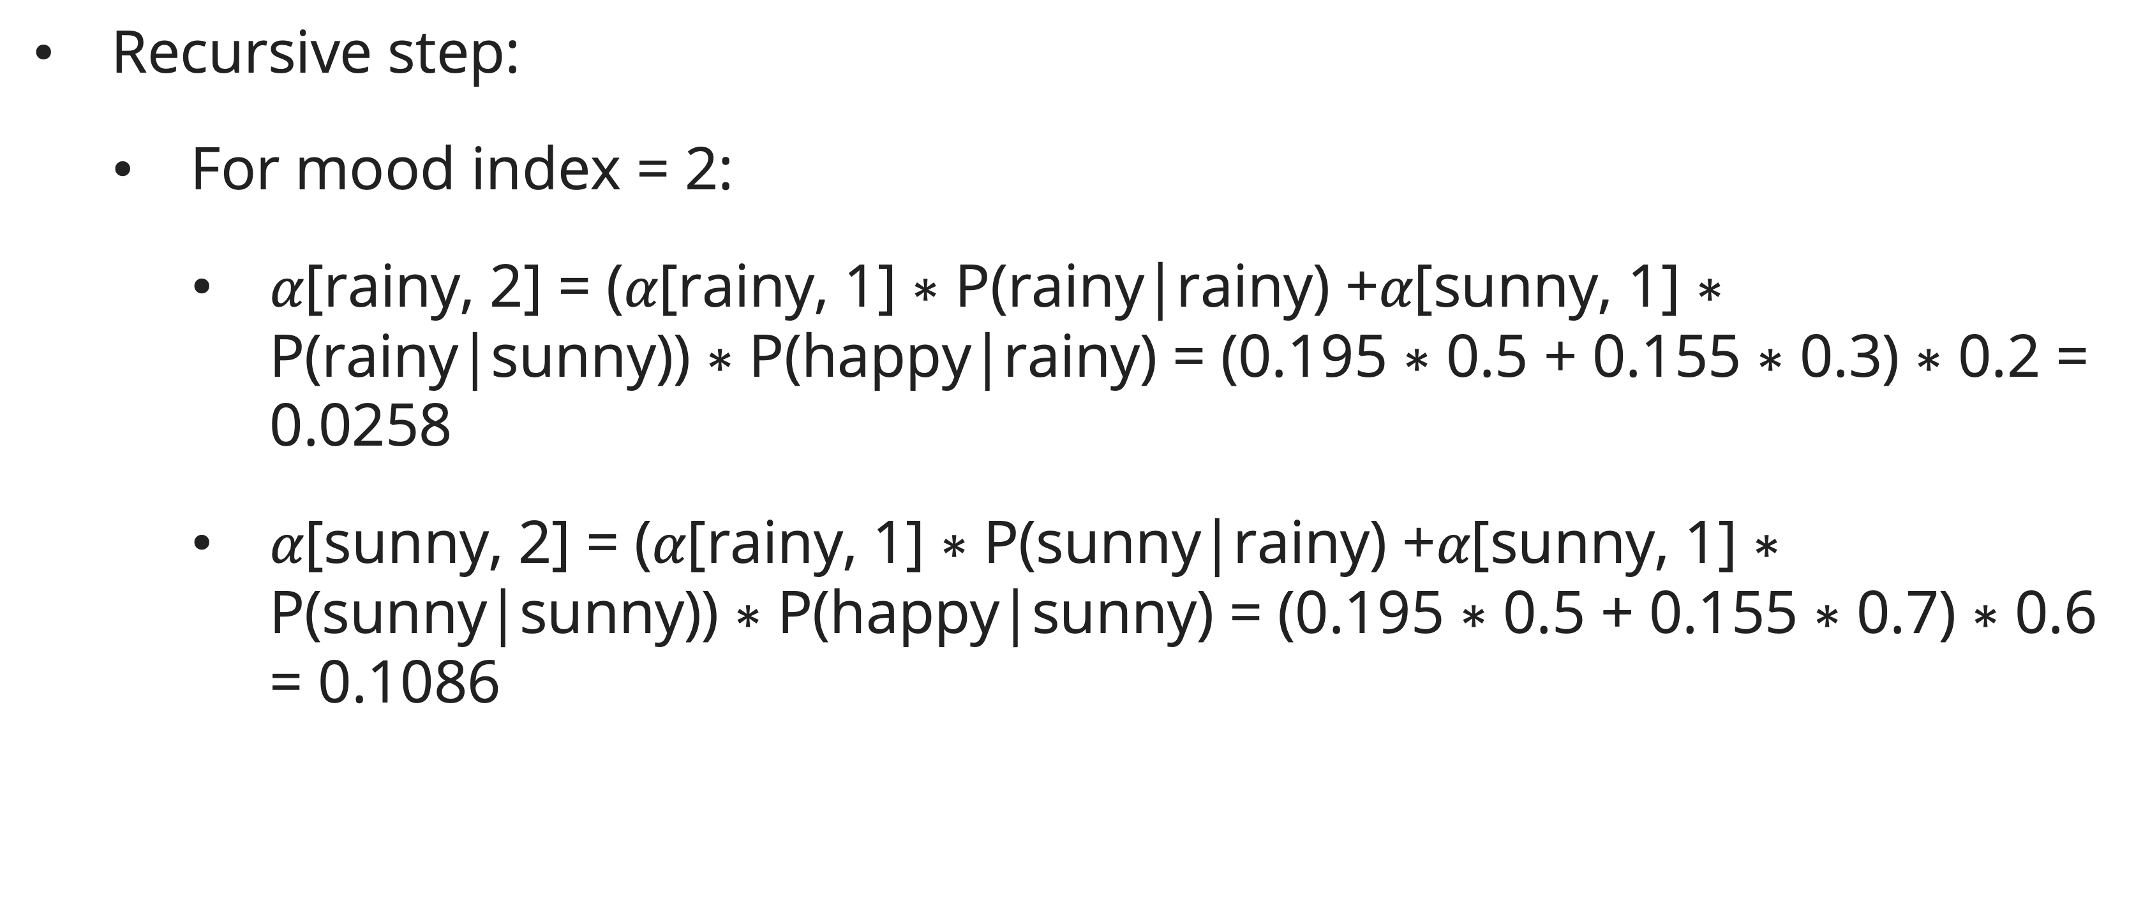
Forward algorithm
example
Recursive step:
  For mood index = 2:
    $α\text{[}\text{rainy}\text{, 2] = (}α\text{[}\text{rainy}\text{, 1] ∗ }\text{P}\text{(}\text{rainy}\text{|}\text{rainy}\text{) +}α\text{[}\text{sunny}\text{, 1] ∗ }\text{P}\text{(}\text{rainy}\text{|}\text{sunny}\text{)) ∗ }\text{P}\text{(}\text{happy}\text{|}\text{rainy}\text{) = (0.195 ∗ 0.5 + 0.155 ∗ 0.3) ∗ 0.2 = 0.02}\text{58}$
    $α\text{[}\text{sunny}\text{, 2] = (}α\text{[}\text{rainy}\text{, 1] ∗ }\text{P}\text{(}\text{sunny}\text{|}\text{rainy}\text{) +}α\text{[}\text{sunny}\text{, 1] ∗ }\text{P}\text{(}\text{sunny}\text{|}\text{sunny}\text{)) ∗ }\text{P}\text{(}\text{happy}\text{|}\text{sunny}\text{) = (0.195 ∗ 0.5 + 0.155 ∗ 0.7) ∗ 0.6 = 0.1}$086

Slide 44
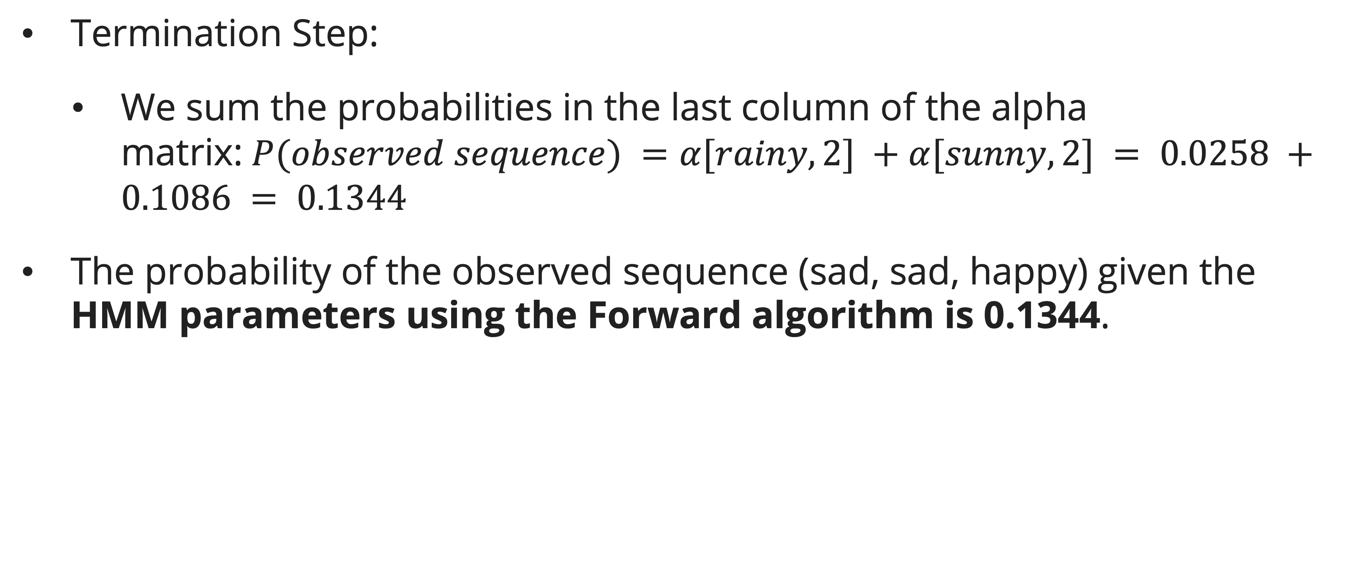
Forward algorithm
example
Termination Step:
  We sum the probabilities in the last column of the alpha matrix:$P(observed sequence) =α[rainy, 2] +α[sunny, 2] = 0.0258 +0.1086 = 0.1344$
The probability of the observed sequence (sad, sad, happy) given the HMM parameters using the Forward algorithm is 0.1344.

Slide 45
Exercise
You are playing guess with your siblings, you are assuming if today is sunny then the probability tomorrow is sunny 0.8, however if today is rainy, then the probability tomorrow is rainy is 0.3. What are the probability is rainy in 2 days, if today is rainy?

Slide 46
Exercise
We investigate the weather in the Land of Oz. to illustrate the principles without too much heavy calculation.) The weather here is not very good there are never two fine days in a row. If the weather on a particular day is known, we cannot predict exactly what the weather will be the next day, but we can predict the probabilities of various kinds of weather. We will say that there are only three kinds: fine, cloudy and rain.
  After a fine day, the weather is equally likely to be cloudy or rain.
  After a cloudy day, the probabilities are 1/4 fine, 1/4 cloudy and 1/2 rain.
  After rain, the probabilities are 1/4 fine, 1/2 cloudy and 1/4 rain
Find the probabilities three days later, if today is a fine day.

Slide 47
Exercise
Consider Jack who is living in Gotham city, the city is unique only have three weather rainy, and sunny and only occur once a day, and tomorrow weather depends on the today weather. In one day, Jack can have two mood sad or happy and depend on weather. Supposed we observed: the first two days Jack is happy, while the third day is sad . What is the probability of this observed sequence given the parameters of our HMM with Forward Algorithm?
Note: The Initial Probability P(rainy) = 0.35; P(sunny) = 0.65

Slide 48
References
Session 12
Rosen, K. H. (2012). Discrete mathematics and its applications (7th ed). McGraw-Hill.
Russell, S. J., Norvig, P., Chang, M., Devlin, J., Dragan, A., Forsyth, D., Goodfellow, I., Malik, J., Mansinghka, V., Pearl, J., & Wooldridge, M. J. (2022). Artificial intelligence: A modern approach (Fourth edition, global edition). Pearson.
https://www.cs.jhu.edu/~phi/ai/slides/lecture-first-order-logic.pdf

